Slide 1
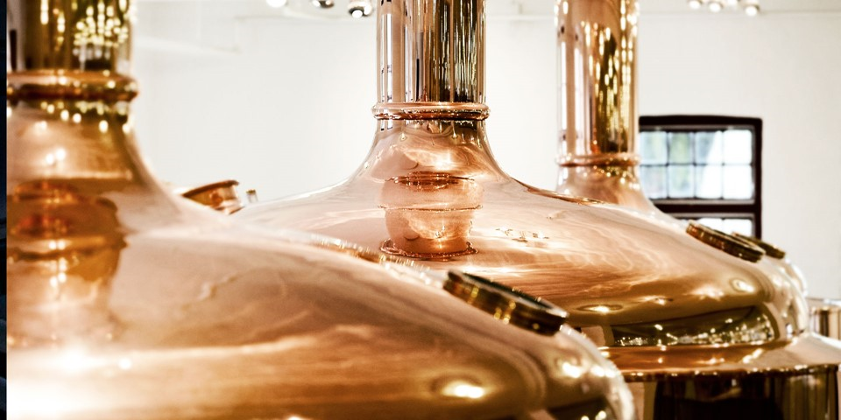
Branding and Performance in the Global Beer Market Erik Strøjer Madsen Koldingfjord, Januar 2018

Slide 2
Take away
Increasing global market share for the lager beer
High income elasticities of lager beer in developing countries
High price premium on premium lager
M&A strategies motivated by the growth of premium lager

Slide 3
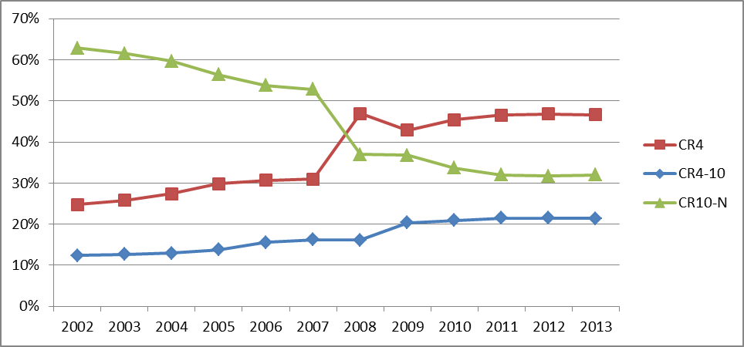
Increasing concentration

Slide 4
World market for beer
 | Quantity consumed (Bill liter) |  |  | Value of consumption (Bill USD)
Type of beers | 2016 | Freq. 2016 | % 2000-16 | 2016 | Freq. 2016 | % 2000-16
Standard lager | 139.7 | 73.4 | 55.6 | 335.8 | 59.1 | 53.9
Premium lager | 30.6 | 16.1 | 31.8 | 143.8 | 25.3 | 45.1
Ales and stouts | 5.7 | 3.0 | 14.6 | 23.7 | 4.2 | 16.2
Specialty beers | 9.0 | 4.7 | 27.8 | 47.4 | 8.3 | 42.8
Low alcohol beers | 5.3 | 2.8 | 108.0 | 18.0 | 3.2 | 110.9
Total beer cons. | 190.3 | 100.0 | 49.2 | 568.7 | 100.0 | 50.0
Increasing market share for Lager beer
No inflation in beer prices

Slide 5
Regional markets
 | Number of | Standard lager |  | Premium lager |  | Specialty beers
World regions | Countries | 2016 | % 2000-16 | 2016 | % 2000-16 | 2016 | % 2000-16
Africa & M. E. | 5 | 4.6 | 51.5 | 0.7 | 29.6 | 0.2 | 32.3
Asia | 14 | 72.9 | 130.9 | 7.3 | 78.2 | 0.4 | 69.4
South America | 5 | 24.5 | 45.0 | 1.5 | 233.7 | 0.6 | 95.6
North America | 2 | 12.9 | 0.8 | 7.9 | -3.2 | 4.6 | 15.8
West Europe | 16 | 13.0 | -23.3 | 6.9 | 0.0 | 2.5 | 19.3
East Europe | 5 | 11.9 | 37.6 | 6.3 | 103.8 | 0.7 | 56.8
All countries | 47 | 139.7 | 55.6 | 30.6 | 31.8 | 9.0 | 27.8
Note: Consumption measured in billions of liters.
Increasing market share for Lager beer in developing countries

Slide 6
Income elasticities
Log (T_{ijk}) = α + β_{k} Log (G_{ij}) + δ_{k} (Log (G_{ij}))² + η_{k} X_{ij} + λ_{j} + μ_{ijk}
T_{ijk} Type k beer in country j, year i
G_{ij} GDP year i for country j
X_{ij} Controlling variables
λ_{j} Country fixed effects

Slide 7
Income elasticities
 | Model 1 | Model 2 | Model 3
 | Pooled OLS | Fixed effects | Fixed effects
Type of beers | β_{k} | β_{k} | β_{k} | δ_{k}
Standard lager | 0.659 | 0.220 | 3.297 | -0.169
Premium lager | 1.140 | 0.422 | 3.086 | -0.144
Ales and stouts | 1.435 | 0.109 | 1.423 | -0.071
Specialty beers | 1.650 | 0.288 | 0.020⁺ | 0.015⁺
Low alcohol beers | 1.407 | 0.226 | 0.731⁺ | -0.027⁺
Total beer cons. | 0.764 | 0.247 | 2.791 | -0.138
High and decreasing elasticity for premium lager
Constant elasticity for specialty and low alcohol beer

Slide 8
Average price of beer
World regions | Standard lager | Premium lager | Specialty beers | Ales and stouts | Low alcohol beers | Total beer cons.
Africa & M. E. | 2.22 | 2.46 | 5.34 | 2.14 | 2.01 | 2.35
Asia | 2.10 | 4.53 | 5.14 | 6.76 | 3.23 | 2.38
South America | 2.09 | 2.58 | 2.64 | 2.06 | 2.29 | 2.13
North America | 2.51 | 4.28 | 5.39 | 3.70 | 3.70 | 3.58
West Europe | 4.93 | 6.74 | 6.52 | 5.81 | 4.48 | 5.61
East Europe | 2.14 | 3.95 | 2.51 | 1.90 | 2.07 | 2.71
All countries | 2.40 | 4.70 | 5.29 | 4.14 | 3.41 | 2.99
High price premium for premium lager beer

Slide 9
Price premiums

Slide 10
Premiumization of the market
Results of blind test experiments for lager beers
No real differences in quality or taste
Large perceived differences in branded beers
Results:
Branding competitions
Investment in sales promotions and advertising

Slide 11
Premiumization of the market
Vertical product differences? NO!
Known technology with same raw material
Blind test experiments for lager beers:
Almenberg et al: Triangle test of Czechvar, Heineken and Stella Artios
Result: The only one different could not be pointed out (Only 33%)
Horizontal product differences? YES
Blind test experiments for lager beers:
McConnell: Same beer with 3 labels of popular, premium and super-premium
Result: Panel ranked high priced beer higher in quality
Consumer perceived the quality of beer by price signals

Slide 12
8 large breweries
 | World Market share | Marketing & sales expenses Billion USD | Marketing and sales cost Share of revenue
Company | 2012 | 2012 | 2002 | 2012
AB Inbev | 0.195 | 5.250 | 0.188 | 0.132
SAB Miller | 0.117
Heineken | 0.101 | 1.350 | 0.154 | 0.122
Carlsberg | 0.054 | 1.238 | 0.201 | 0.183
Molson Coors | 0.041 | 1.126 | 0.280 | 0.288
Kirin | 0.032 | 2.904 | 0.192 | 0.134
Tsing Tao | 0.038 | 0.449 | 0.162 | 0.153
Yanjing | 0.034 | 0.157 | 0.077 | 0.104
Total | 0.612 | 12.481
Average | 0.077 |  | 0.179 | 0.159

Slide 13
Concentration and performance

Slide 14
Development in premiums
World regions | Premium lager Billion USD | Price premium Percent | Price premium increases % 2000-2016 | Size of premium Billion USD | Total premium increases % 2000-2016
Africa & M. E. | 1.7 | 10.7 | -2.74 | 0.16 | 27.4
Asia | 33.2 | 106.1 | 4.59 | 17.81 | 84.52
South America | 4.0 | 23.6 | -9.54 | 0.76 | 153.2
North America | 33.6 | 70.2 | 16.36 | 13.90 | 48.2
West Europe | 46.2 | 36.9 | -7.14 | 12.44 | -7.8
East Europe | 25.2 | 84.4 | 17.29 | 11.52 | 375.6
All countries | 143.8 | 95.8 | 11.25 | 56.56 | 64.5
High competition in Western Europe for lager beer
Asia has the most profitable market for Lager beer

Slide 15
Conclusions
High income elasticities in developing countries
High price premium on premium lager
M&A strategies motivated by growth of premium lager

Slide 16
Thank you for your time! Questions?

