Slide 1
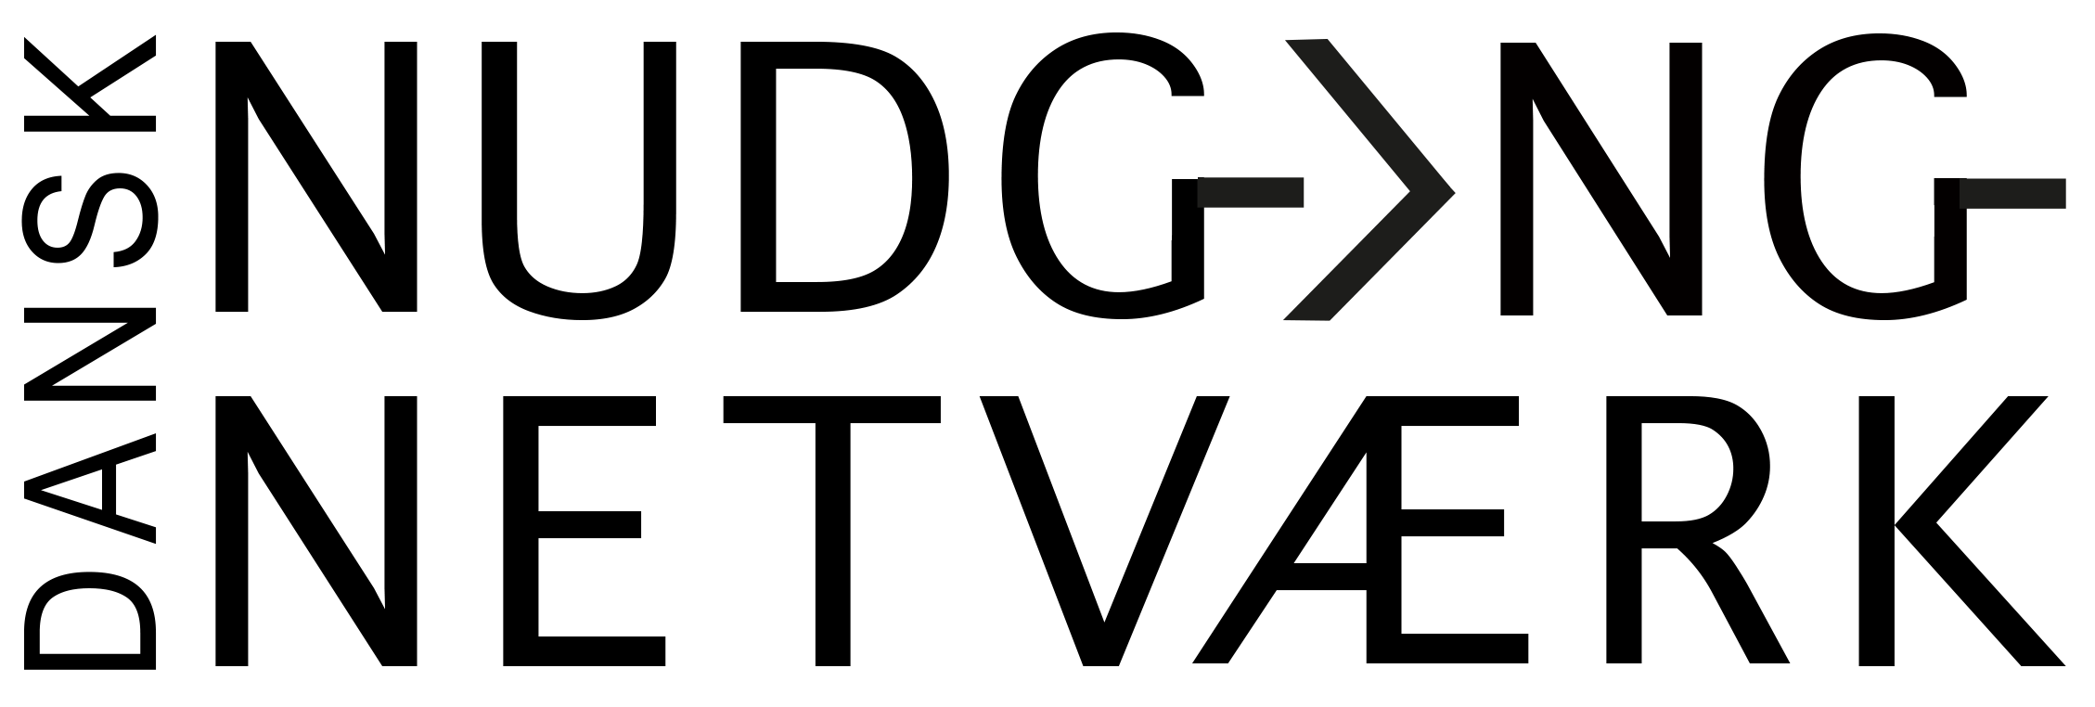
Behavioural Insights & BPP
National Økonomisk Forenings Årsmøde 2018,
13 Januar, Kolding Fjord
iNudgeyou
The Applied Behavioural Science Group
Pelle Guldborg Hansen,
Behavioural Scientist, Ph.D. / CBIT, Roskilde University
Director of ISSP – The Initiative for Science, Society & Policy
Chairman of The Danish Nudge Network
CE of INUDGEYOU team
twitter: @peguha

Slide 2
Konsekvens A
Konsekvens B
Handling A
Handling B
Beslutnings-punkt
Overvejelse
Opmærksomhed
Præferencer
Formodninger
Værdier
information

Slide 3
Valgadfærd: Den Asymmetriske Dominans Effekt
SUBSCRIPTIONS
Welcome to the Economist Subscription Centre
Pick the type of subscription you want to buy or renew.
❏Economist.com subscription – US $59.00 One-year subscription to Economist.com. Includes online access to all articles from The Economist since 1997.
68 %
16 %
❏Print subscription – US $125.00 One-year subscription to the print edition of The Economist.
❏Print & web subscription – US $125.00 One-year subscription to the print edition of The Economist and online access to all articles from The Economist since 1997.
32 %
84 %
iNudgeyou© 2017

Slide 4
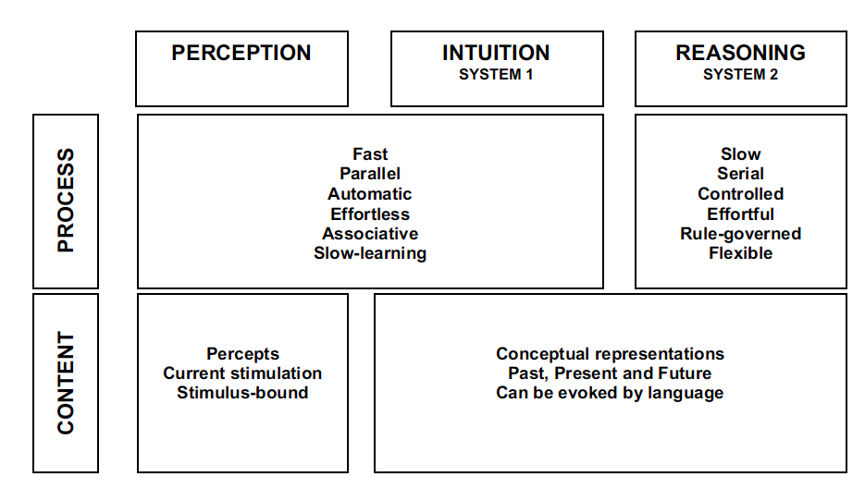
Kahneman, D (2002) Maps of Bounded Rationality: A Perspective on Intuitive Judgment and Choice, Prize Lecture, December 8.
Hurtigt
Parallelt
Automatisk
Associativt
Erfaringsbaseret
Langsomt
Serielt
Kontrolleret
Regel-baseret
Fleksibelt

Slide 5
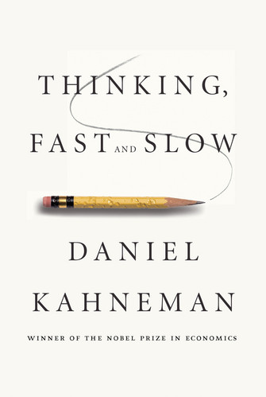
Daniel Kahneman, Dual Process Theory

Slide 6
Decision-making and behavioral biases
Anchoring – the common human tendency to rely too heavily, or "anchor," on one trait or piece of information when making decisions.
Attentional Bias – implicit cognitive bias defined as the tendency of emotionally dominant stimuli in one's environment to preferentially draw and hold attention.
Backfire effect - Evidence disconfirming our beliefs only strengthens them.
Bandwagon effect – the tendency to do (or believe) things because many other people do (or believe) the same. Related to groupthink and herd behavior.
Bias blind spot – the tendency to see oneself as less biased than other people.^{[2]}
Choice-supportive bias – the tendency to remember one's choices as better than they actually were.^{[3]}
Confirmation bias – the tendency to search for or interpret information in a way that confirms one's preconceptions.^{[4]}
Congruence bias – the tendency to test hypotheses exclusively through direct testing, in contrast to tests of possible alternative hypotheses.
Contrast effect – the enhancement or diminishing of a weight or other measurement when compared with a recently observed contrasting object.^{[5]}
Denomination effect – the tendency to spend more money when it is denominated in small amounts (e.g. coins) rather than large amounts (e.g. bills).^{[6]}
Distinction bias – the tendency to view two options as more dissimilar when evaluating them simultaneously than when evaluating them separately.^{[7]}
Empathy gap - the tendency to underestimate the influence or strength of feelings, in either oneself or others.
Endowment effect – "the fact that people often demand much more to give up an object than they would be willing to pay to acquire it".^{[8]}
Experimenter's or Expectation bias – the tendency for experimenters to believe, certify, and publish data that agree with their expectations for the outcome of an experiment, and to disbelieve, discard, or downgrade the corresponding weightings for data that appear to conflict with those expectations.^{[9]}
Focusing effect – the tendency to place too much importance on one aspect of an event; causes error in accurately predicting the utility of a future outcome.^{[10]}
Framing effect – drawing different conclusions from the same information, depending on how that information is presented.
Hostile media effect - the tendency to see a media report as being biased due to one's own strong partisan views.
Hyperbolic discounting – the tendency for people to have a stronger preference for more immediate payoffs relative to later payoffs, where the tendency increases the closer to the present both payoffs are.^{[11]}
Illusion of control – the tendency to overestimate one's degree of influence over other external events.^{[12]}
Impact bias – the tendency to overestimate the length or the intensity of the impact of future feeling states.^{[13]}
Information bias – the tendency to seek information even when it cannot affect action.^{[14]}
Irrational escalation – the phenomenon where people justify increased investment in a decision, based on the cumulative prior investment, despite new evidence suggesting that the decision was probably wrong.
Loss aversion – "the disutility of giving up an object is greater than the utility associated with acquiring it".^{[15]} (see also Sunk cost effects and Endowment effect).
Mere exposure effect – the tendency to express undue liking for things merely because of familiarity with them.^{[16]}
Money illusion – the tendency to concentrate on the nominal (face value) of money rather than its value in terms of purchasing power.^{[17]}
Moral credential effect – the tendency of a track record of non-prejudice to increase subsequent prejudice.
Negativity bias – the tendency to pay more attention and give more weight to negative than positive experiences or other kinds of information.
Neglect of probability – the tendency to completely disregard probability when making a decision under uncertainty.^{[18]}
Normalcy bias – the refusal to plan for, or react to, a disaster which has never happened before.
Omission bias – the tendency to judge harmful actions as worse, or less moral, than equally harmful omissions (inactions).^{[19]}
Outcome bias – the tendency to judge a decision by its eventual outcome instead of based on the quality of the decision at the time it was made.
Planning fallacy – the tendency to underestimate task-completion times.^{[13]}
Post-purchase rationalization – the tendency to persuade oneself through rational argument that a purchase was a good value.
Pseudocertainty effect – the tendency to make risk-averse choices if the expected outcome is positive, but make risk-seeking choices to avoid negative outcomes.^{[20]}
Reactance – the urge to do the opposite of what someone wants you to do out of a need to resist a perceived attempt to constrain your freedom of choice.
Restraint bias – the tendency to overestimate one's ability to show restraint in the face of temptation.
Selective perception – the tendency for expectations to affect perception.
Semmelweis reflex – the tendency to reject new evidence that contradicts a paradigm.^{[21]}
Social comparison bias – the tendency, when making hiring decisions, to favour potential candidates who don't compete with one's own particular strengths.^{[22]}
Status quo bias – the tendency to like things to stay relatively the same (see also loss aversion, endowment effect, and system justification).^{[23][24]}
Unit bias — the tendency to want to finish a given unit of a task or an item. Strong effects on the consumption of food in particular.^{[25]}
Wishful thinking – the formation of beliefs and the making of decisions according to what is pleasing to imagine instead of by appeal to evidence or rationality.^{[26]}
Zero-risk bias – preference for reducing a small risk to zero over a greater reduction in a larger risk.
Social biases
Most of these biases are labeled as attributional biases.
Actor–observer bias – the tendency for explanations of other individuals' behaviors to overemphasize the influence of their personality and underemphasize the influence of their situation (see alsoFundamental attribution error), and for explanations of one's own behaviors to do the opposite (that is, to overemphasize the influence of our situation and underemphasize the influence of our own personality).
Dunning–Kruger effect – a twofold bias. On one hand the lack of metacognitive ability deludes people, who overrate their capabilities. On the other hand, skilled people underrate their abilities, as they assume the others have a similar understanding.^{[37]}
Egocentric bias – occurs when people claim more responsibility for themselves for the results of a joint action than an outside observer would.
Forer effect (aka Barnum effect) – the tendency to give high accuracy ratings to descriptions of their personality that supposedly are tailored specifically for them, but are in fact vague and general enough to apply to a wide range of people. For example, horoscopes.
False consensus effect – the tendency for people to overestimate the degree to which others agree with them.^{[38]}
Fundamental attribution error – the tendency for people to over-emphasize personality-based explanations for behaviors observed in others while under-emphasizing the role and power of situational influences on the same behavior (see also actor-observer bias, group attribution error, positivity effect, and negativity effect).^{[39]}
Halo effect – the tendency for a person's positive or negative traits to "spill over" from one area of their personality to another in others' perceptions of them (see also physical attractiveness stereotype).^{[40]}
Illusion of asymmetric insight – people perceive their knowledge of their peers to surpass their peers' knowledge of them.^{[41]}
Illusion of transparency – people overestimate others' ability to know them, and they also overestimate their ability to know others.
Illusory superiority – overestimating one's desirable qualities, and underestimating undesirable qualities, relative to other people. (Also known as "Lake Wobegon effect," "better-than-average effect," or "superiority bias").^{[42]}
Ingroup bias – the tendency for people to give preferential treatment to others they perceive to be members of their own groups.
Just-world phenomenon – the tendency for people to believe that the world is just and therefore people "get what they deserve."
Moral luck – the tendency for people to ascribe greater or lesser moral standing based on the outcome of an event rather than the intention
Outgroup homogeneity bias – individuals see members of their own group as being relatively more varied than members of other groups.^{[43]}
Projection bias – the tendency to unconsciously assume that others (or one's future selves) share one's current emotional states, thoughts and values.^{[44]}
Self-serving bias – the tendency to claim more responsibility for successes than failures. It may also manifest itself as a tendency for people to evaluate ambiguous information in a way beneficial to their interests (see also group-serving bias).^{[45]}
System justification – the tendency to defend and bolster the status quo. Existing social, economic, and political arrangements tend to be preferred, and alternatives disparaged sometimes even at the expense of individual and collective self-interest. (See also status quo bias.)
Trait ascription bias – the tendency for people to view themselves as relatively variable in terms of personality, behavior, and mood while viewing others as much more predictable.
Ultimate attribution error – similar to the fundamental attribution error, in this error a person is likely to make an internal attribution to an entire group instead of the individuals within the group.
Memory errors and biases
Cryptomnesia – a form of misattribution where a memory is mistaken for imagination.
Egocentric bias – recalling the past in a self-serving manner, e.g., remembering one's exam grades as being better than they were, or remembering a caught fish as being bigger than it was.
False memory – confusion of imagination with memory, or the confusion of true memories with false memories.
Hindsight bias – filtering memory of past events through present knowledge, so that those events look more predictable than they actually were; also known as the "I-knew-it-all-along effect."^{[31]}
Positivity effect – older adults remember relatively more positive than negative things, compared with younger adults^{[46]}
Reminiscence bump – the effect that people tend to recall more personal events from adolescence and early adulthood than from other lifetime periods.
Rosy retrospection – the tendency to rate past events more positively than they had actually rated them when the event occurred.
Self-serving bias – perceiving oneself responsible for desirable outcomes but not responsible for undesirable ones.
Suggestibility – a form of misattribution where ideas suggested by a questioner are mistaken for memory.
Telescoping effect – the effect that recent events appear to have occurred more remotely and remote events appear to have occurred more recently.
Von Restorff effect – the tendency for an item that "stands out like a sore thumb" to be more likely to be remembered than other items.

Slide 7
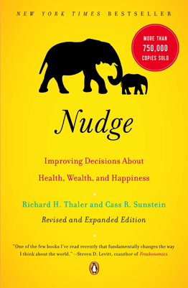
Thaler, R. & Sunstein, C. (2008) Nudge: Improving Decisions About Health, Wealth, and Happiness
Thaler, R. & Sunstein, C. (2009) Nudge: Improving Decisions about Health, Wealth, and Happiness, Revised and Expanded Edition, New York: Penguin Books

Slide 8
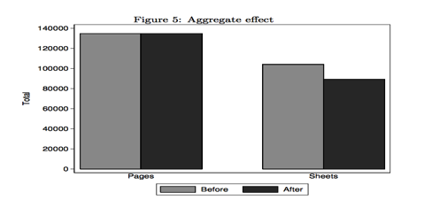
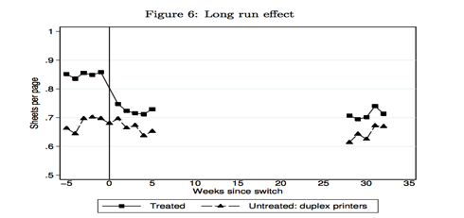
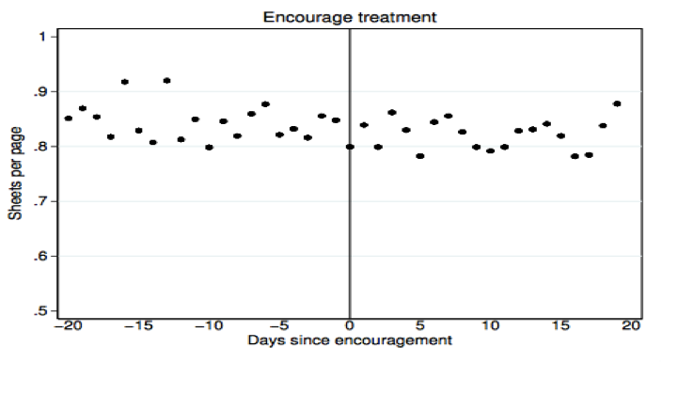
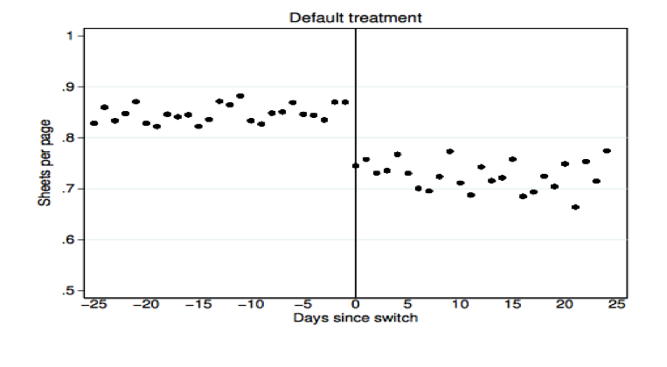
Egebark, J., & Ekström, M. (2013). Can Indifference Make the World Greener? Sweden: Research Institute of Industrial Economics.
Egebark, J., & Ekström, M. (2013). Can Indifference Make the World Greener? Sweden: Research Institute of Industrial Economics.

Slide 9
Effekten af opt-in og opt-out for valg af buffet
Gruppe 1:
Til konferencen vil der blive serveret ikke-vegetarisk buffet til frokost. Angiv, hvis du ønsker at få tilberedt en vegetarisk anretning.
Gruppe 2:
Til konferencen vil der blive serveret vegetarisk buffet til frokost. Angiv, hvis du ønsker at få tilberedt en ikke-vegetarisk anretning.

Slide 10
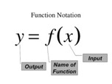
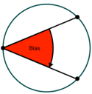
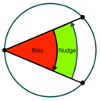
Nudge – a theoretical definition
A nudge is a function of any attempt at influencing people’s judgment, choice or behaviour in a predictable way, that is (1) made possible because of cognitive limitations, biases, routines, and habits in individual and social decision-making posing barriers for people to perform rationally in their own self-declared interests, and which (2) works by making use of those limitations, biases, routines, and habits as integral parts of such attempts.
Hansen, PG (2016) The Definition of Nudge and Libertarian Paternalism: Does the hand fit the glove? The European Journal of Risk Regulation

Slide 11
Nudge – a theoretical definition
A nudge is a function of any attempt at influencing people’s judgment, choice or behaviour in a predictable way, that is (1) made possible because of cognitive limitations, biases, routines, and habits in individual and social decision-making posing barriers for people to perform rationally in their own self-declared interests, and which (2) works by making use of those limitations, biases, routines, and habits as integral parts of such attempts.
Thus a nudge is not about:
forbidding or adding any rationally relevant choice options,
changing incentives, whether regarded in terms of time, trouble, social sanctions, economic and so forth, or
the provision of additional information and rational argumentation.
Hansen, PG (2016) The Definition of Nudge and Libertarian Paternalism: Does the hand fit the glove? The European Journal of Risk Regulation

Slide 12
SAVE MORE TOMORROW
Thaler, R & Benatzi , S (2004) Save More Tomorrow: Using Behavioral Economics to Increase Employee Saving, Journal of Political Economy, 2004, vol. 112, no. 1, pt. 2

Slide 13
